Slide 1
Warehouse and Retail Sales
.

Slide 2
Capstone-Project- Warehouse and Retail Sales.
BIA Capstone Project - Warehouse and Retail Sales.
Problem Statement :
To enhance operational efficiency and gain deeper market insights, this project is aimed at conducting product clustering analysis using historical sales data. The primary objective is to group similar products based on sales patterns, thereby discerning trends, optimizing inventory management processes.

Slide 3
Steps :
Importing Libraries
Import Data
Data Summary
Data Visualization
Data Cleaning ( EDA )
Feature Selection
Model Selection
Hyperparameter Tuning
Conclusion

Slide 4
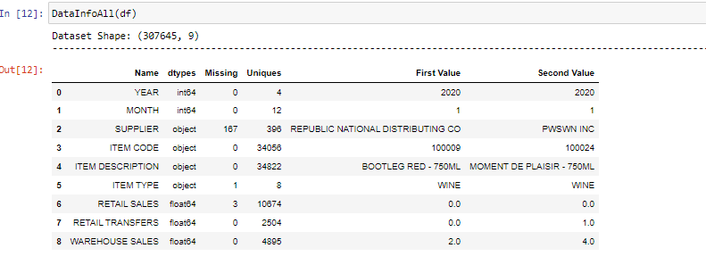
Data info :

Slide 5
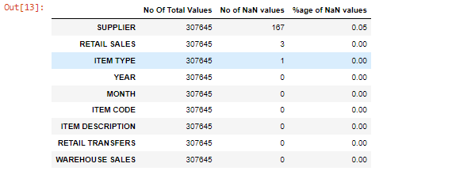
Checking duplicate values & non values

Slide 6
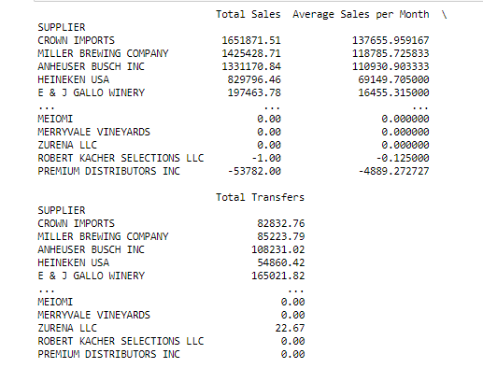
Supplier Performance

Slide 7
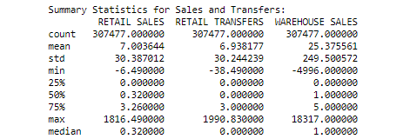
Summary Statistics for Sales and Transfers

Slide 8
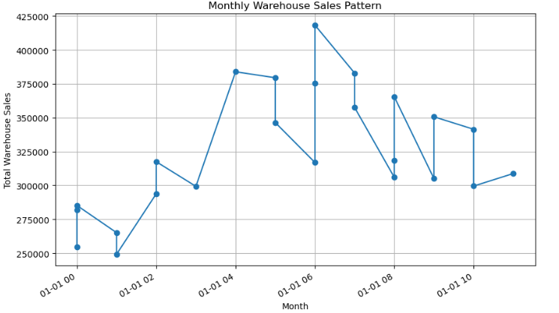
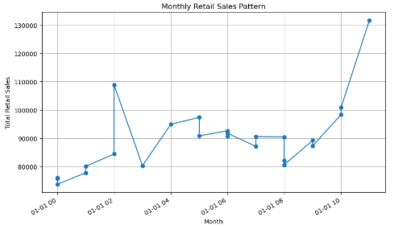
Sales patterns

Slide 9
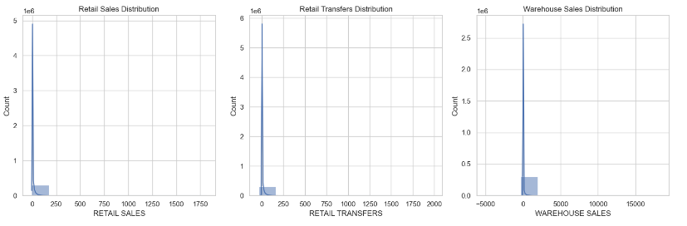
Visualizations like Histograms

Slide 10
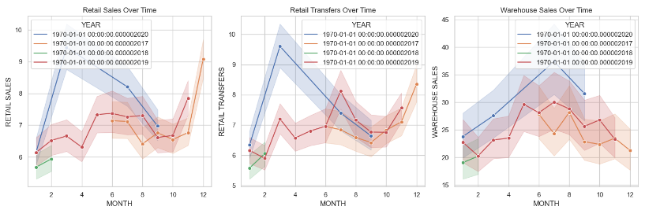
Visualizations like line plots

Slide 11
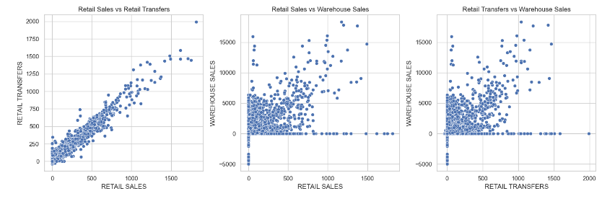
Visualizations like Scatter plots

Slide 12
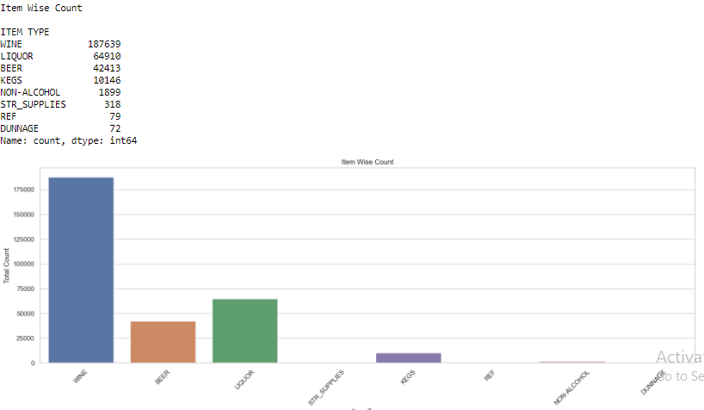
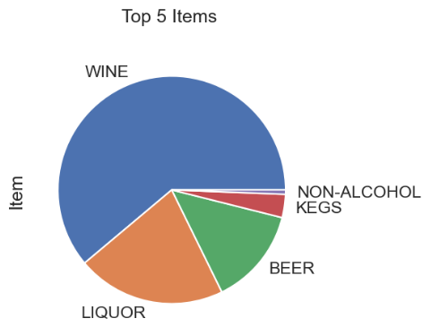
Item wise count & Top 5 Items

Slide 13
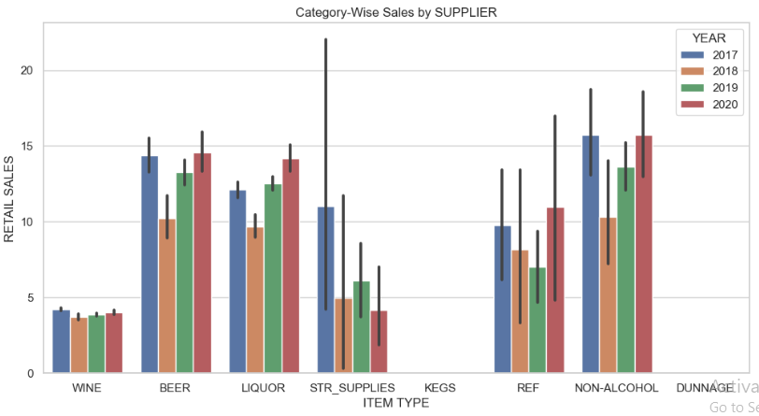
Category-Wise Sales by SUPPLIER

Slide 14
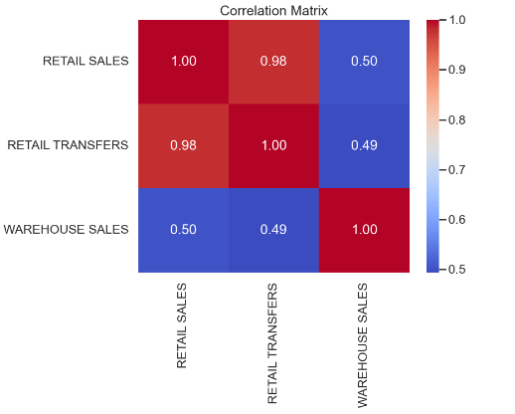
Exploring relationships between variables

Slide 15
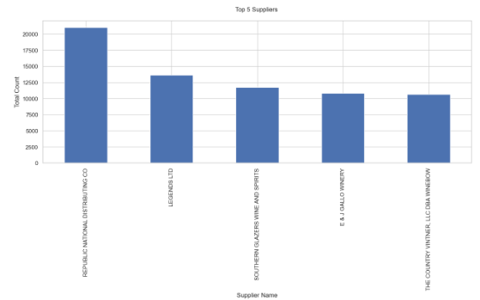

Top 5 Supplieies

Slide 16
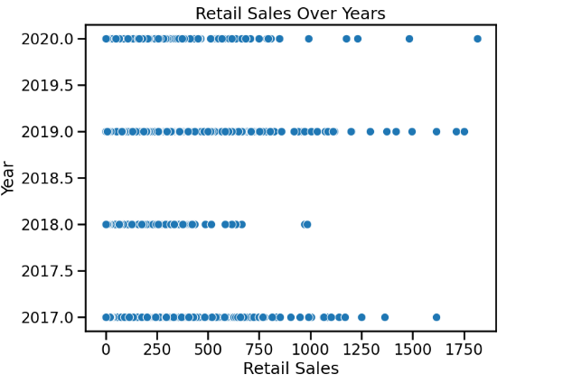
scatter plot on retail sales over years

Slide 17
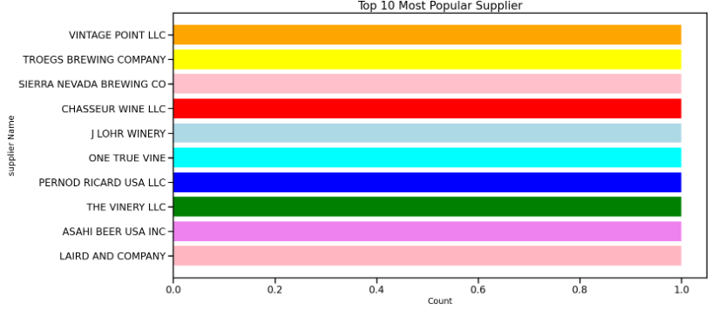
Top 10 Most Popular Supplier

Slide 18
Conclusions :
The analysis revealed the following insights
Total retail sales increased steadily over the months.
Supplier E & J GALLO WINERY had the highest warehouse sales.
Warehouse sales were significantly lower than retail sales.

Slide 19
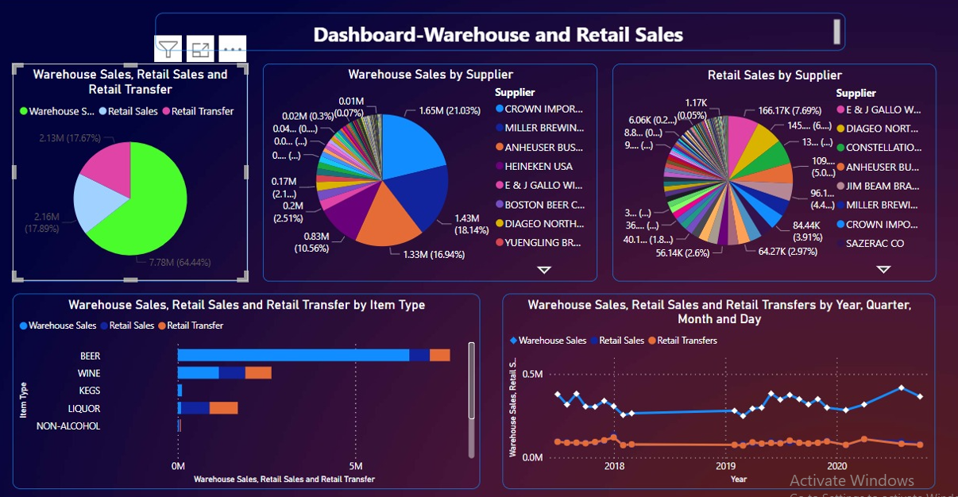
Power bi dashboard

